Slide 1

GCIS-124
Software Development & Problem Solving
10: Networking II

Slide 2

HTTP
Connecting to the world via a computer network is now a ubiquitous part of daily life. You are most likely doing it right now to attend this class.
This unit we will learn how to interact with other computers using the hypertext transfer protocol (HTTP).
We will be exploring the basics HTTP:
GET
POST
HTTP Server
Separation of Concerns
We'll start by looking at the HTTP protocol and creating a simple server that can service a web page.
It is difficult to imagine life without computer networks. This unit we'll continue to explore how to use them in your code.

Slide 3
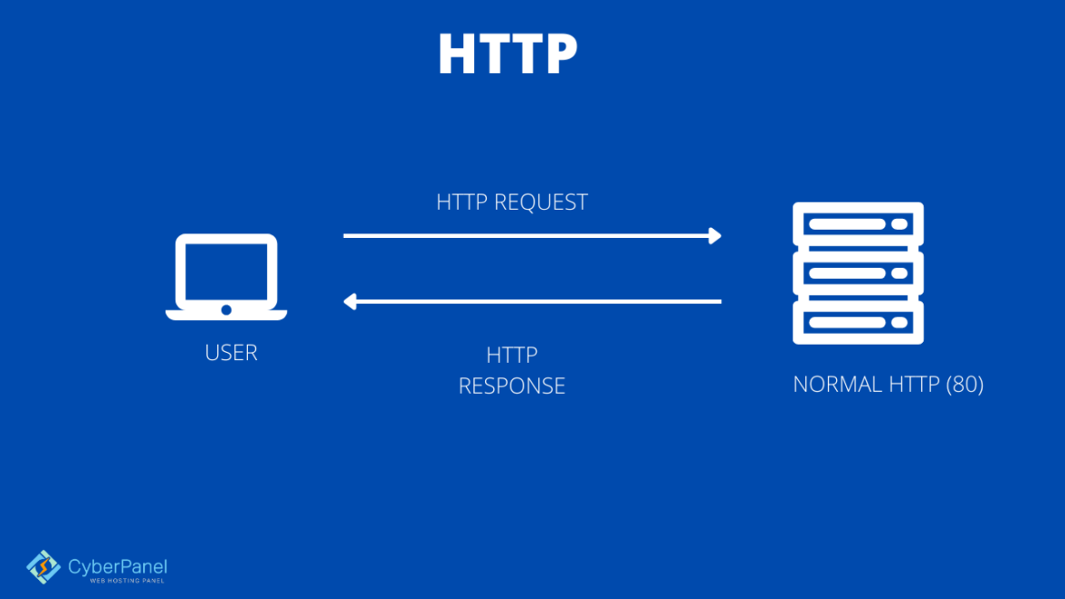
Hypertext Transfer Protocol (HTTP)
HTTP is the primary protocol used to connect to resources on the web.
It is client initiated, meaning the client always sends a request to start a transaction.
The server always responds.
Even if the response is, "I don't know what to do"
The server will never send unsolicited/ asynchronous messages to the client .
While there are several variants we'll only use HTTP 1.1
This is probably the most common one in use
It is the only one in use with ASCII fields
HTTP is a simple protocol with only a few possible methods, of which we'll focus on:
GET - Request a resource from the server. Commonly used to get an html web page.
POST - Request to process a resource. This involves sending additional data that can be used by the server to manage/change the resource.
HTTP is the protocol that is used to connect the word through a web of interconnected computers.
Notes:
🔹 1. GET
Purpose: Retrieve data from the server
Example: Fetch a webpage or API data
Key points:
No data modification
Parameters sent in URL
Can be cached
👉 Example:
GET /users?id=10
🔹 2. POST
Purpose: Send data to the server (create a resource)
Example: Submit a form, create a new user
Key points:
Data sent in request body
Not idempotent (repeating creates duplicates)
👉 Example:
POST /users Body: { "name": "John" }
🔹 3. PUT
Purpose: Update/replace an entire resource
Example: Replace user data completely
Key points:
Idempotent (same request → same result)
👉 Example:
PUT /users/10 Body: { "name": "John Updated" }
🔹 4. PATCH
Purpose: Partially update a resource
Example: Update only one field
Key points:
More efficient than PUT for small updates
👉 Example:
PATCH /users/10 Body: { "name": "John Updated" }
🔹 5. DELETE
Purpose: Remove a resource
Example: Delete a user
Key points:
Idempotent (deleting again has no effect)
👉 Example:
DELETE /users/10
🔹 6. HEAD
Purpose: Same as GET but returns only headers
Use case: Check if a resource exists or get metadata
👉 Example:
HEAD /users/10
🔹 7. OPTIONS
Purpose: Get supported methods for a resource
Use case: Used in CORS (preflight requests)
👉 Example:
OPTIONS /users
🔹 8. TRACE
Purpose: Echo the received request (debugging)
Rarely used due to security concerns
🔹 9. CONNECT
Purpose: Establish a tunnel (used for HTTPS via proxies)

Slide 4
HTTP Message Format
All HTTP messages follow a standard format.
Each message is divided into two main components separated by a blank line.
Headers - Contains metadata about the request/response.
Message type
Protocol
Content type
Content length
...
Body - Contains any data associated with the message.
Format must match the content type in the header
Is optional, for example GET requests will not have a body.
GET /~gcis-124/calendar_03_2255.html HTTP/1.1
Accept: text/html
Accept-Encoding: gzip
Accept-Language: en-US,en;q=0.9
DNT: 1
Host: www.se.rit.edu
Referer: https://www.se.rit.edu/~gcis-124/
Sec-Fetch-Dest: document
Sec-Fetch-Mode: navigate
Sec-Fetch-Site: same-origin
...
The above is an abridged version of the HTTP request for www.se.rit.edu/~gcis-124

Slide 5
Simple GET Request Example
Let's look at abbreviated GET request for our course page (se.rit.edu/~gcis-124)
Message type, requested resource, and protocol are on the first line.
GET /~gcis-124/calendar_03_2255.html HTTP/1.1
Accept: text/html
Accept-Encoding: gzip
Accept-Language: en-US,en;q=0.9
Host: www.se.rit.edu
Referer: https://www.se.rit.edu/~gcis-124/
The rest of the lines are all header fields in the format Field: value.
The header is terminated with a blank line.
Most GET requests will not have a body section.
Notes:
Instructors are encouraged to take just a moment to talk about the specific header fields with the understanding we won't be using them in our software.
🔹 Request Headers (sent by client)
Host – Specifies the domain name of the server (required in HTTP/1.1).
User-Agent – Identifies the client (browser, app, OS).
Accept – Defines what content types the client can process (e.g., JSON, HTML).
Accept-Encoding – Lists supported compression methods (e.g., gzip, br).
Accept-Language – Indicates preferred language(s) for the response.
Authorization – Contains credentials for authenticating the client.
Cookie – Sends stored cookies from client to server.
Content-Type – Specifies the format of the request body (e.g., application/json).
Content-Length – Size of the request body in bytes.
Referer – Indicates the URL of the previous page making the request.
Origin – Identifies the origin (scheme + host + port) of the request (used in CORS).
Connection – Controls whether the network connection stays open (keep-alive/close).
Cache-Control – Directives for caching behavior (e.g., no-cache).
🔹 Response Headers (sent by server)
Content-Type – Specifies the media type of the response body.
Content-Length – Size of the response body in bytes.
Set-Cookie – Sends cookies from server to client.
Cache-Control – Defines caching rules for the response.
Expires – Specifies when the response becomes stale.
ETag – Unique identifier for a resource version (used for caching).
Last-Modified – Timestamp of when the resource was last changed.
Location – URL for redirection (used with 3xx responses).
Server – Information about the server software.
WWW-Authenticate – Indicates authentication method required.
Access-Control-Allow-Origin – Specifies allowed origins for CORS.
Access-Control-Allow-Methods – Lists allowed HTTP methods for CORS.
Access-Control-Allow-Headers – Lists allowed headers in requests (CORS).
Transfer-Encoding – Indicates encoding for message body (e.g., chunked)

Slide 6
HttpStream
As we saw in the last unit, socket based streams only complete when the stream is closed
We worked around it by closing the input or output stream
This won't work from HTTP where your web browser is normally the client
Faculty wrote a utility to make working with HTTP data as a stream easier.
This is not part of the standard library
Basically it makes a stream that completes on a blank line
It has a very simple interface:
constructor - takes an input stream
lines() - returns a Stream<String> of the lines in the message up to a blank line
readline() - returns the next line in the message
readChars(n) - returns up to the next n chars as a string.
close() - closes the input stream
ServerSocket serverSocket = new
ServerSocket(8001);
Socket clientSocket = serverSocket.accept();
try (HttpStream streamer = new HttpStream(
clientSocket.getInputStream())) {
streamer.lines().forEach(System.out::println);
} catch (IOException e) {
System.err.println("ERROR: "+ e.getMessage());
}
serverSocket.close();
The HttpStream class allows you to work with socket input streams the same way as files by using the lines() method.
Notes:
public Stream<String> lines() {
return br.lines()
.takeWhile(line -> !line.isEmpty())
.onClose(() -> {
// IMPORTANT: do NOT close br (would close socket).
// We want to keep the reader open to read body.
});
}

Slide 7
10.1
GETting Our First Message
Now that we've learned a little bit about HTTP messages, let's try reading a simple GET request. You can use your browser as the client and we'll write a small program using the HttpStream to read the request.
ServerSocket serverSocket = new
ServerSocket(8001);
Socket clientSocket = serverSocket.accept();
try (HttpStream streamer = new HttpStream(
clientSocket.getInputStream())) {
streamer.lines().forEach(System.out::println);
} catch (IOException e) {
System.err.println("ERROR: "+ e.getMessage());
}
serverSocket.close();
Create a new activities package and class named GetRequest inside it.
In main, create a server socket on port 8081.
Accept a connection using a standard socket.
Using the HttpStream class, print out each line in the request message.
Run your program. In a web browser of your choice, navigate to localhost:8081
Verify a GET message was printed in your terminal.
Your browser will give an error for this activity because we didn't send a response but you should be able to see the request message.

Slide 8
Response Messages
The will vary depending on the webserver response message to the client uest type but in general, it has the same two pieces as any HTTP message:
Header
Body
Each response starts with a code identifying how the request was handled. Some common codes are:
200 OK: Everything worked as expected and the response is contained in the message.
204 No Content: Everything worked but the response has no content.
400 Bad Request: The server could not understand the request.
404 Not Found: The server could not locate the requested URL.
500 Internal Server Error: The request could not be fulfilled because the server encountered an error.
HTTP/1.1 200 OK
Content-Length: 22
Content-Type: text/plain;
charset=utf-8
Response was received!
Response messages look pretty similar to request messages except they often have a body in addition to the header.
Notes:
Response should match the content type and content length information.

Slide 9
Simple GET Response Example
Let's look at a simple response to the GET message we sent earlier.
The protocol and response code are on the first line.
HTTP/1.1 200 OK
Content-Length: 22
Content-Type: text/plain; charset=utf-8
Response was received!
Header lines follow indicating how long the body (content) is and its encoding.
The body of the message is all the data after the header. It does not have a specific format unlike the header fields.
A blank line separates the header from the body. This is required.
Notes:
Instructors are encouraged to take just a moment to talk about the specific header fields with the understanding we won't be using them in our software.

Slide 10
10.2
Response
All HTTP messages should receive a response. Let's write one for the GET message we tried sending earlier.
In GetRequest's main send back a string message:
Use a PrintWriter to send a response on the sockets output stream
The message format should be:
"HTTP/1.1 200 OK\r\n
Content-Length: <message length>\r\n
Content-Type: text/plain;charset=utf-8\r\n\r\n
<message>"
<Message> should be a custom string you come up with. If you store it in a variable, you can use String.length to get the <message length> rather than hard coding it.
Rerun your program and navigate to localhost:8081 again and verify your message is displayed in your browser.
Socket client = new Socket("somehost", 54321);
OutputStream out = client.getOutputStream();
PrintWriter printer = new PrintWriter(out);
printer.println("John Denver");
printer.flush();
client.close();
When using a new line in an HTTP message, you must use "\r\n".
Notes:
Run 1 -> with simple text
Run 2 -> Run with html content. Don’t forget to ensure that content type is set correctly.

Slide 11
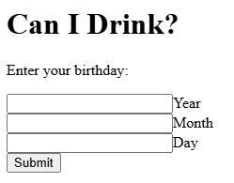
10.3
Sending Data
While not the most colorful web page, it was still nice to see our message show up in the browser. But what if we need to send data to the server, instead of just getting data from it. Let's try that now and see what the message looks like.
You've been provided an html page, unit10/activities/view/canIDrink.html, which has some simple form data in it.
Take a quick look at it with your instructor.
As this isn't a web course we won't be going over HTML in detail.
Do notice the action is set to "http://localhost:8081". This is how the web page knows where to send the request and is where our server should be.
Enter in your birthday for each field with each value being an integer.
Example: Year: 2005, Month: 06, Day: 12
Start your GetRequest application.
Press the submit button and look at the request sent to your server.
While the provided web page may look like something out of the early 90s, it has everything we need to send some data to our server.
Notes:
Prompt: what is the date of birth to be valid drinking age
Check the Chrome DevTool → Payload to show the data coming
In the code use http stream to read the incoming data.

Slide 12
POST Request
Right off the bat, you'll notice the operation type is POST.
POST / HTTP/1.1
Host: localhost:8081
Connection: keep-alive
Content-Length: 25
Cache-Control: max-age=0
...
Content-Type: application/x-www-form-urlencoded
...
Accept-Encoding: gzip, deflate, br, zstd
Accept-Language: en-US,en;q=0.9
year=2005&month=06&day=12
This in common when the request includes additional information.
The content-Length field lets us know how much data was sent.
At the moment, your code isn't reading the data/request body so you won't see it. We'll fix that in a moment.
Notes:
Show the payload in the browser
Content-Type: application/x-www-form-urlencoded
This header tells the server that the request body contains form data encoded as key-value pairs in URL format.

Slide 13
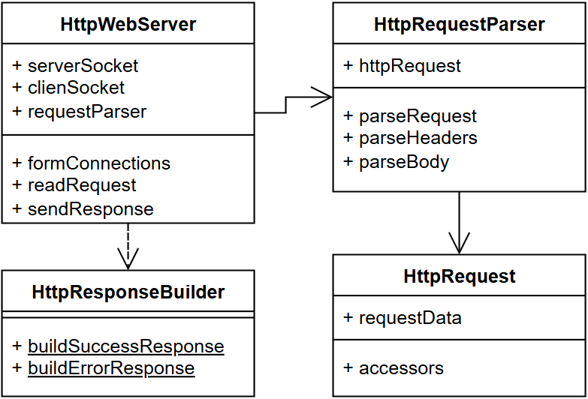
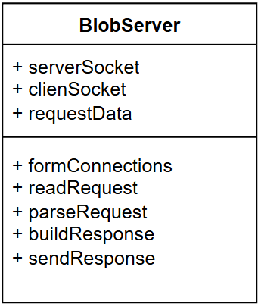
Separation of Concerns
Now that we're getting data in the request, we'll need to actually parse it rather than sending a blanket response.
While we could keep going with our current file putting everything in one place isn't always the best idea.
A common OO practice is to break each piece of functionality up into its own class.
This is known as Separation of Concerns.
Each class is only concerned with only a single responsibility, or task.
This increases reusability.
And makes testing easier.
While this may at first feel like more work, it's a time proven tactic to increase efficiency over time through reuse.
Instead of having one specialized Blob class, we should use several more generic reusable pieces that can be put together in a specialized way.

Slide 14
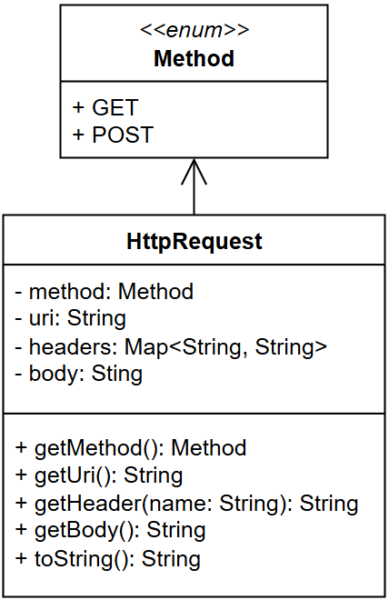
10.4
HttpRequest
We'll start with a container to hold an HTTP request. It will allow easy access to the request method (GET/POST), URI, headers, and body.
In the httpserver package, implement the the UML depicted on the left it. Include an initializing constructor for all fields.
The Method enumeration can be an inner class.
For the line POST / HTTP/1.1
POST is the method
/ is the URI (we'll do more with this later)
HTTP/1.1 is the protocol but we only use HTTPv1.1 so it won't be stored
Headers is a map of attribute to values. For the line Content-Length: 25
Conent-Length would be the key
25 would be the value
The body is the content of the message. For our previous example that would be:
year=2005&month=06&day=12
toString should use the format:
HTTPRequest {method: <method>, uri: <uri>, headers: <headers>, body: <body>}
Understanding what each piece in the class will help with future steps.

Slide 15
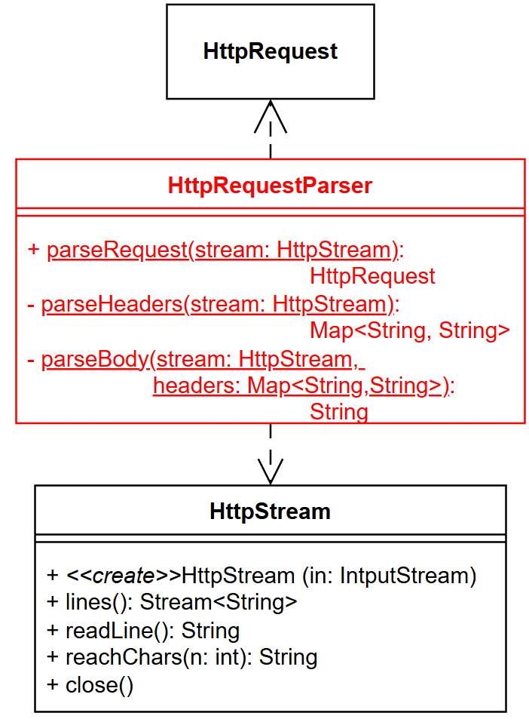
10.5
HttpRequestParser - parseRequest
Next we'll implement the HttpRequestParser which will create HttpRequests.
Add an HttpRequestParser class to the httpserver package.
All of the methods will be static.
Use the UML on the left to help guide your implementation.
Start with parseRequest. It should:
Read the first line from the stream and split it into the three parts (method, uri, protocol (ignored)).
Hint: Make use the Method.valueOf() method.
Use parseHeaders to get create the headers map.
Stub out parseHeaders by returning an empty HashMap.
Use parseBody to get the body string.
Stub out parseBody by returning null.
Put all the pieces into a HttpRequest and return it.
Tests have been provided in HttpRequestParserTest.txt (change to .java).
The first test should pass.
You may want to add prints as you read the parts so you can see if something went wrong.

Slide 16
10.6
HttpRequestParser - parseHeader
Let's continue to implement the HttpRequestParser.
All of the methods will be static.
Use the UML on the left to help guide your implementation.
parseHeaders can use the lines() method from the HttpStream
Split each line on a ": " and use those as a key/value pair in a map.
Headers are case insensitive so lowercase the keys.
Collectors.toMap(keyMapper, valueMapper) could be useful here
Use it with the Stream.collect method similar to toList
Alternatively you can use the Stream.forEach method
Tests have been provided in HttpRequestParserTest.txt (change to .java).
The second test should now pass.
You may want to add prints as you read the parts so you can see if something went wrong.
Notes:
public String[] split(String regex, int limit): Limits the number of resulting substrings.
.map(s -> s.split(": ", 2)) → Ensure that only 2 substring is created

Slide 17
10.7
HttpRequestParser
Finally, let's finish the HttpRequestParser.
All of the methods will be static.
Use the UML on the left to help guide your implementation.
parseBody should return the contents of the the request
if Content-Length exists and is greater than 0.
Use the HttpStream.readChars method to read Content-Length characters since the web form does not newline terminate its body.
Tests have been provided in HttpRequestParserTest.txt (change to .java).
All tests should now pass.
You may want to add prints as you read the parts so you can see if something went wrong.

Slide 18
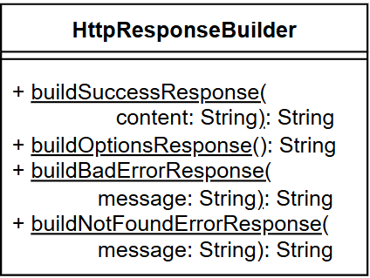
10.8
HttpResponseBuilder
The HttpResponseBuilder has been provided for you. Take a minute to look over it and ask if you have any questions.
Since the HttpResponse builder is mostly hard coded text, it has been provided instead of you having to type it out.
There are four messages in it currently:
200 - Message for letting the client know everything went as expected and has the response content.
204 - Message that will be used to respond to a client OPTIONS request (more on this later).
400 - Message letting the client know the server did not understand the request. Any error message that was generated on the server side will be passed back as the content.
404 - Message letting the client know the requested uri is unsupported or incorrect. Any error message that was generated on the server side will be passed back as the content.
The Access-Control-Allow-Origin: * line lets the client know its allowed to allowed to use this message.
At the moment we could leave it off but later on, some of the stuff we use will need it.
Building the response is straightforward but a little wordy. For this reason, the solution has been provided for you.
You may also notice an Access-Control-Allow-Headers header. We'll cover this later.
Notes:
CORS: Cross-Origin Resource Sharing.
1. Access-Control-Allow-Origin
What it does
This response header tells the browser which origin is allowed to access the resource.
Example:
Access-Control-Allow-Origin: https://studentapp.com
This means: Only JavaScript running on pages from https://studentapp.com may access this response.
Wildcard
Access-Control-Allow-Origin: *
Any origin is allowed.

Slide 19
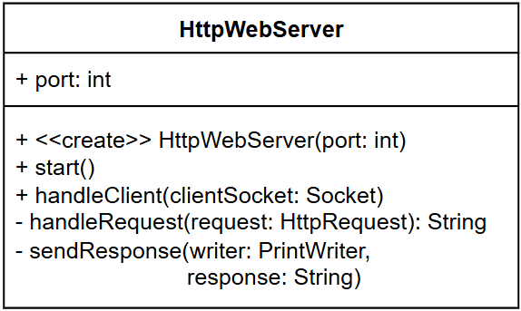
10.9
HttpWebServer
Now that we have all the components ready, let's put them together to make a server.
Create a new HttpWebServer in the httpserver package.
It will be modeled after the GetRequest you did earlier.
In start:
create a ServerSocket
in a while true loop
accept a client connection and create the client Socket
call handleClient with the client socket
handleClient should:
Encapsulate the input and output streams in an HttpStream and PrintWriter
Use parseRequest to read the HTTP Request
Print the parsed request
Call handleRequest to create an HttpResponse
Call sendResponse to send the response to the server
Close the socket
sendResponse should write the response to the output stream, flush the stream, and print the response.
At the moment, have handleRequest create and return a success response message with the content, "Request Received!"
In main, run your server, navigate to the provided html page, enter the information and press the submit button. You should get a response.
Lots of little pieces are going to make our server more flexible, reusable, and testable. All good things.

Slide 20

10.10
favicon.ico???
We're almost there but you probably noticed an extra message from the client. That's because your web browser asked it for an icon to display next to the URL (favicon.ico). While a pain, most modern browsers do this so we'll need to handle that case.
Solving this problem, is where the URI comes in, that piece of information after the method that we've been collecting.
It informs us of what the request is looking for.
Let's update our code to only accept messages to the "/" URI and handle that icon.
In your handleRequest, if the URI is not "/", return null.
In handleClient, if handleRequest returns null, send an 404 error response of "<URI> not found".
Use the buildNotFoundErrorResponse method instead of buildSuccessResponse
Restart your server and verify it responds to both requests.
When dealing with commercial grade software you'll often find lots of extra stuff. Sometimes we can ignore it but sometimes we have to manage it.
Notes:
That request:
GET /.well-known/appspecific/com.chrome.devtools.json HTTP/1.1
is a harmless, automatic request generated by Google Chrome (DevTools)—not something your application explicitly sends.

Slide 21
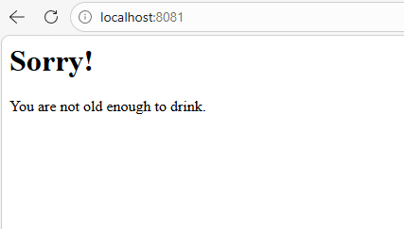
10.11
Request Handle Logic
Hopefully everything works, if not, raise your hand to get some assistance. At the moment, your sending a static response back, that doesn't do much. We can fix that by adding some logic to the handleRequest message.
Update the handleRequest method to use the message body.
Split the message into parts using "&" as the separator
Split each part using "=" as the separator
Alternatively, you could create a dictionary the same way as we did for the headers.
Use the data to calculate the users age
If you turn the age into a string in "<year>-<month>-<day>" format you can use String.compareTo to check if it's before or after a set date.
If the age is 21 or older, send a congratulatory response message
If not, send response indicating they will have to wait a little longer
Run your server again and verify you get the expected response.
If you have time, try and make the response prettier by adding in a little html.
You can use AI to help you with the html formatting
I used the following HTML for the above response.
"<html><body><h1>Sorry!</h1><p>You are not old enough to drink.</p></body></html>"

Slide 22
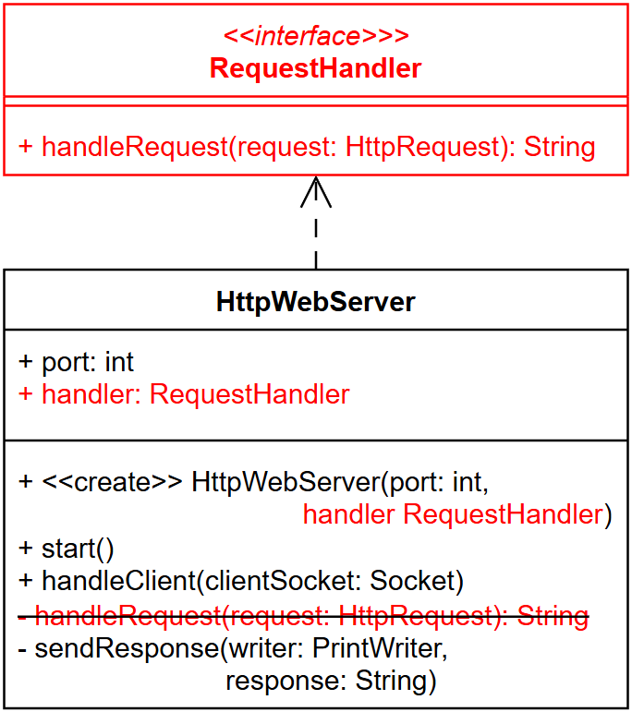
10.12
RequestHandler Interface
Right now, our server only works for one type of request. While we could make a seperate server for each application, it would be better to outsource the handleRequest to its own class.
In the httpserver package, create a RequestHandler interface.
Use the UML on the left as a guide.
In HttpWebServer, add a RequestHandler instance to the class.
Use the UML as a guide.
Edit handleClient to call handler.handleRequest, instead of handleRequest.
In the activities package, make a DrinkingAgeHandler that implements RequestHandler.
Cut and paste the handleRequest message from HttpWebServer.
Create a new DrinkingAgeServer in activities. The server should:
Create an instance of DrinkingAgeHandler
Create an instance of HttpWebServer on port 8081 using the handler created in the previous step.
Call start on the server.
Run your new server and verify everything works as before.
Making handleRequest its own object will greatly increase the reusability of our server.

Slide 23
10.13
Guessing Game!
You have been provided with a completely functional implementation of a Guessing Game in the guessing package. Examine the code now and make sure that you understand how to play the game using the provided CLI.
I’m thinking of a number between 1 and 100.
A random number between 1 and 100 is generated by the game.
The player has 6 guesses to try and find the number.
The player can restart the game at any time with a new number to guess.
The LocalGuessingGame class will play the game locally from a command line.
Try it out!
Look at the code!
Raise your hand with questions.

Slide 24
Protocols
In order to communicate, two computers must speak the same language
A protocol is a specification of the format of the messages and the rules governing those messages that two or more machines must follow in order to communicate
Protocols usually exist in two forms:
A textual specification meant for humans to read and understand
This is used by developers to implement the protocol
A coded implementation created by humans for computers to use and understand
Both forms should specify the precise interpretation of every message and how to respond
??
Aloha!
??
こんにちは
If two machines don’t speak the same language, communication is not possible.
Let’s design a protocol that uses strings terminated by newlines to communicate!

Slide 25
10.14
Guessing Game Protocol
Our ultimate goal is to implement a version of the Guessing Game that can be played over a network connection. Before we do that, we must clearly define the protocol that will be used to communicate between the client and server. To keep things simple, we will make sure that each request and response is a single line of text.
Request From Client | Response(s) From Server
I’m thinking of a number between 1 and 100.

Slide 26
10.14
Guessing Game Protocol
Our ultimate goal is to implement a version of the Guessing Game that can be played over a network connection. Before we do that, we must clearly define the protocol that will be used to communicate between the client and server. To keep things simple, we will make sure that each request and response is a single line of text.
Request From Client | Response(s) From Server
I’m thinking of a number between 1 and 100.
QUIT
GAME_OVER
RESTART
RESTARTED
GUESS #
TOO_LOW
TOO_HIGH
CORRECT
OUT_OF_GUESSES
bad request (any other message)
ERROR

Slide 27
10.15
Guessing Game Server
You will need to write a server that listens for connections from clients and then reads messages from the clients that want to play a game. You already have a perfectly functioning implementation of the Guessing Game, so there is no need to rewrite any of that logic. Instead, your server will use the existing class and interpret messages from the client to decide which methods to call on the game. Easy! Right?
I’m thinking of a number between 1 and 100.
You also already have a working server (HttpServer). Now you just need to enshrine the logic in a RequestHandler.
Create a new GuessingGameHandler that implements RequestHandler in the guessing package.
In the constructor
Create and store and instance of the Guessing Game
Add a stub method handleRequest, which will be used at a later time to handle the logic.
Create a GuessingGameServer in its own file. In its main :
Create a GuessingGameHandler
Create an HttpWebServer, using the handler from the first step
Call start of the server

Slide 28
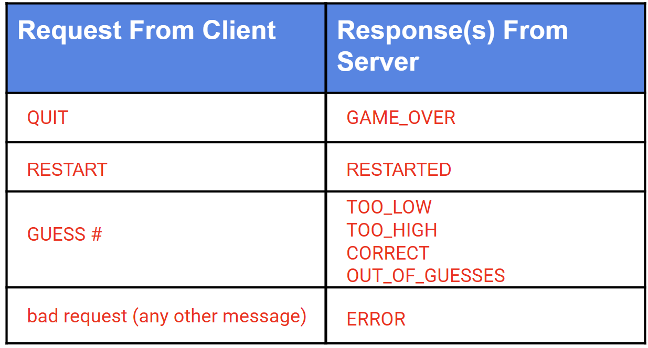
10.16
Guessing Game Handler
The handler isn't finished yet! It will need to read requests from the client, interpret them by calling methods on the game, and return the appropriate response. Update the handleRequest method to do this now!
If the method is not POST, return null.
Get the body from the HttpRequest, this is the request message.
Print the request after it is read.
Determine which method to call on the GuessingGameImpl.
Call the method and formulate a response.
Return the response.
Print each response before returning it
Unit tests have been provided in GuessingGameHandlerTest.txt (change to .java).
Run the server and ensure it doesn't crash

Slide 29
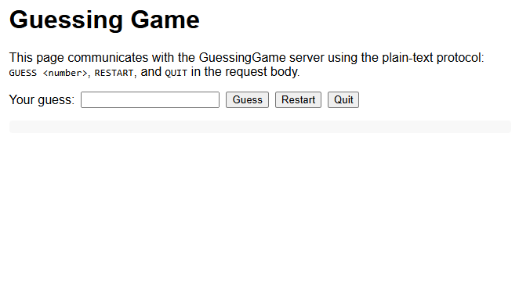
10.17
Creating the Front End
We still need someway to interact with our server. Since we are using HTTP it most likely should be a web page. Since this isn't a course on web development, we'll use AI to fast track us a usable web page.
First, ensure the AI tool you have has our GuessingGameHandler as its context.
In VS code, selecting the file then starting the AI chat will include it as the context.
If using AI in a browser, you'll want to drag the file into the AI chat.
Ask the AI to create a guessing game html page using forms that matches the protocol in the file.
Record what you use for your prompts in a prompt.txt file.
If using the browser, you'll most likely need to copy the html into a file.
If you used VS code with an AI agent, it should make the file for you.
If all went well, you should be able to load the web page into your browser and play the game.
You may need to give the AI a little more information, most likely the port the server is listening on. Or you can hand edit the generated code to add it.
If after a couple attempts you aren't' getting anything to work, a sample has been provided (activities/view/guessing.html).
The webpage AI gave me for the prompt:
Create a guessing game html form page that matches the protocol in this file.
Notes:
This might be a good time to demonstrate your browser dev tools to your students which will allow them to see the messages they are sending even if they aren't getting to the server correctly.

Slide 30
10.18
Two Guessing Games
Hopefully at this point, you are able to play your guessing game. Pretty neat! What happens if you try playing two games at the same time? Try it out and see what happens.
Load two copies of your guessing game html file into your browser.
If your server isn't running, make sure to start it.
Try and play two games at the same time, alternating guesses between them.
In a guessing.txt file, record your thoughts on how this works out and if it's what you would want to happen.
Twice the guessing, twice the fun!?

Slide 31
Multi-Client Servers
What you most likely noticed when playing two games is you are actually playing one game on two clients.
Each attempt affect both but you only see the messages in the client that made this guess
This is confusing and really doesn't scale well
Instead of having one GuessingGameImpl for every client, what we'd really like is to have one for each client.
This will involve a couple updates to our solution which will include:
A system to store and look up handlers based on some type of unique identifier
Adding a unique identifier to the headers sent by the clients
Currently all games share the same object. We need a way to give each game client its own object.

Slide 32
10.19
Server Updates I
The first update involves adding something to keep track of different RequestHandlers by ID. As you probably already guessed, this would be a great place to use a Map.
In your HttpWebServer, replace the single instance of RequestHandler with a Map<String, RequestHandler> and initialize it in the constructor.
Which type of Map should you use for your implementation?
In handleClient, right after parsing the request:
Get the session ID from headers using "x-session-id" as the header key
If the key is found, use the returned handler as the request handler
If they key is not found, create a new GuessingGameHandler to use as the request handler and save it in the map
Use AI to add a unique session id named "x-session-id" to the header of the request message.
Make sure you have your existing html file as the context when making the request
You can use activites/view/guessing_session_id.html if needed
Run your new server and see what happens.
As you guessed, there is going to be an error. See if you can find the HTTP message that is causing the problem.
async function sendCommand(cmd) {
try {
addHistory('SEND', cmd);
const res = await fetch(baseUrl, {
method: 'POST',
body: cmd,
headers: {
'x-session-id': sessionId
}
});
const text = await res.text();
addHistory('RECV', text);
applyResponse(text.trim());
} catch (err) {
applyResponse('ERROR: ' + err.message);
}
}
Somewhere in your AI generated code is going to be a line similar to the highlighted ones. It adds the unique id to the headers.

Slide 33
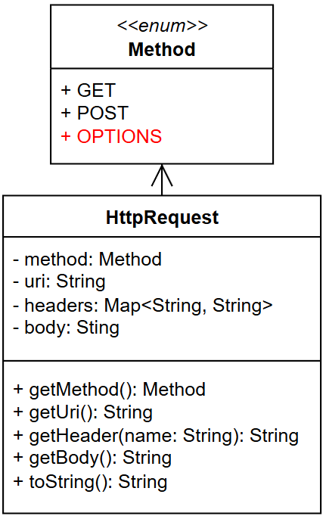
10.20
Solving Problems
The issue crept in when we added something new to the request header. The client now sends us a message asking if it has permission to use that field. While a minor pain, it's better to have the additional layer of security. We'll need to tell the client, it is okay to use.
Luckily we were prepared for this. The buildOptionsResponse in HttpResponseBuilder was created for this purpose.
First add OPTIONS as one of the values in Method (see UML).
In HttpWebServer.handleClient after parsing the request:
Check to see if the request method is OPTIONS
If it is, use HttpResponseBuilder.buildOptionsResponse to create a response
Send the response to the client and return
Restart your server and verify everything is running as expected
Raise your hand if you are having a problem you can't solve
We'll need to manage OPTIONS in addition to GET and POST.

Slide 34
Supplier
Everything works but now our generic server is locked into only working with guessing game.
What we really need is some way to store the object we want to construct in a variable.
This way, it can be passed in rather than having to be hard coded
At first this might feel almost impossible but it's actually pretty simple, thanks to functional interfaces.
In effect, we'll create a reference to a classes constructor that we can call on demand.
To do this we'll use the Supplier<T> interface.
Found in java.util.function.Supplier
Has a single method named get()
Used to encapsulate a method that creates a class as a functional interface
1 public interface Supplier<T> {
2 T get ();
3
4 class MyClass {
5 public String toString () {
6 return "My class string";
7 }
8 }
9
10 public static void main (String[] args) {
11 Supplier<MyClass> myClass =
12 ()-> new MyClass();
13 MyClass instance = myClass.get();
14 System.out.println (instance);
15 }
16 }
The above is an example implementation of the Supplier interface and an example of how it could be used to store a constructor.
Notes:
Instead of the lambda you can also use MyClass::new.

Slide 35
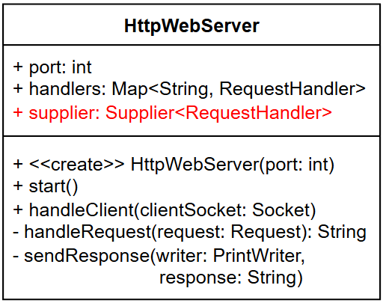
10.21
Server Updates II
One last step to get our server working with any client rather than only guessing game. We'll need to store the implementation constructor in a Supplier and call it from the supplier instead of directly.
In HttpWebServer:
Add a Supplier<RequestHandler> to the class
Pass in the supplier through the constructor
In handleClient, change the call to new GuessingGameImpl to be supplier.get()
In GuessingGameServer, when creating the HttpWebServer:
Pass in a reference to the GuessingGameImpl's constructor
Use ()-> new GuessingGameImpl()
Or GuessingGameImpl::new
Rerun your server and ensure the ractor worked correctly.
Using a supplier let's re-generalize our server to work with any type of RequestHandler.

Slide 36
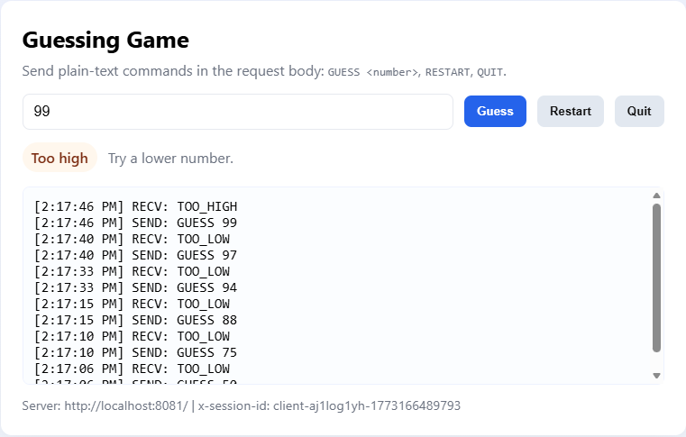
10.22
Bonus Round
We're all done! However, our UI is probably a little boring looking. There is so much more that a modern web page can do. If you have time, try and use AI to spruce up your drinking age and guessing game html.
Use AI to add some flair to the HTML files we created.
Occasionally AI can delete needed code when making additions, for this reason you may want to create new files with the changes rather than purely updating.
See what your seatmates are also doing.
Feel free to talk about what prompts you used to get the desired results.
This is what my guessing game looks like after instructioning the AI to "make it pretty".
I'm sure you can come up with something even better!

Slide 37


Summary & Reflection
What is one thing that you wish you knew more about as we move forward?
HTTP
GET
POST
Separation of Concerns
HTTP Server
Request Handler
Guessing Game
Protocols
Supplier<T>
AI HTML generation
What is one new thing that you learned today?
What one question do you have about today’s class?
Please answer the questions above in your notes for today.

Slide 38
 | InetAddress java.net.InetAddress getByName(String host) getLocalHost() | getHostAddress() getHostname() | URL & URLConnection java.net.URL URL u = new URL(“http://nasa.gov/”); openConnection() getInputStream() connect() getOutputStream()
 | Sockets java.net.Socket Socket sock = new Socket(“localhost”, 1234); |  | OutputStream & PrintWriter Socket::getOutputStream() java.io.PrintWriter PrintWriter writer = new PrintWriter(stream); println(String) write(char[]) flush()
 | InputStream & Scanner Socket::getInputStream() java.util.Scanner |  | ServerSocket java.net.ServerSocket ServerSocket s = new ServerSocket(1234); accept()
 | DatagramPacket & DatagramSocket java.net.DatagramPacket java.net.DatagramSocket
Unit 10: Networking

